Slide 1

Creating Brand Equity

Slide 2
Chapter Questions
What is a brand and how does branding work?
What is brand equity?
How is brand equity built, measured, and managed?
What are the important decisions in developing a branding strategy?

Slide 3
What is a Brand?
A brand is a name, term, sign, symbol or design, or a combination of them, intended to identify the goods or services of one seller or group of sellers and to differentiate them from those of competitors.

Slide 4
The Role of Brands
Identify the maker
Simplify product handling
Organize accounting
Offer legal protection

Slide 5
The Role of Brands
Signify quality
Create barriers to entry
Serve as a competitive advantage
Secure price premium

Slide 6
What is Branding?
Branding is endowing products and services with the power of the brand.

Slide 7
What is Brand Equity?
Brand equity is the added value endowed on products and services, which may be reflected in the way consumers, think, feel, and act with respect to the brand.

Slide 8
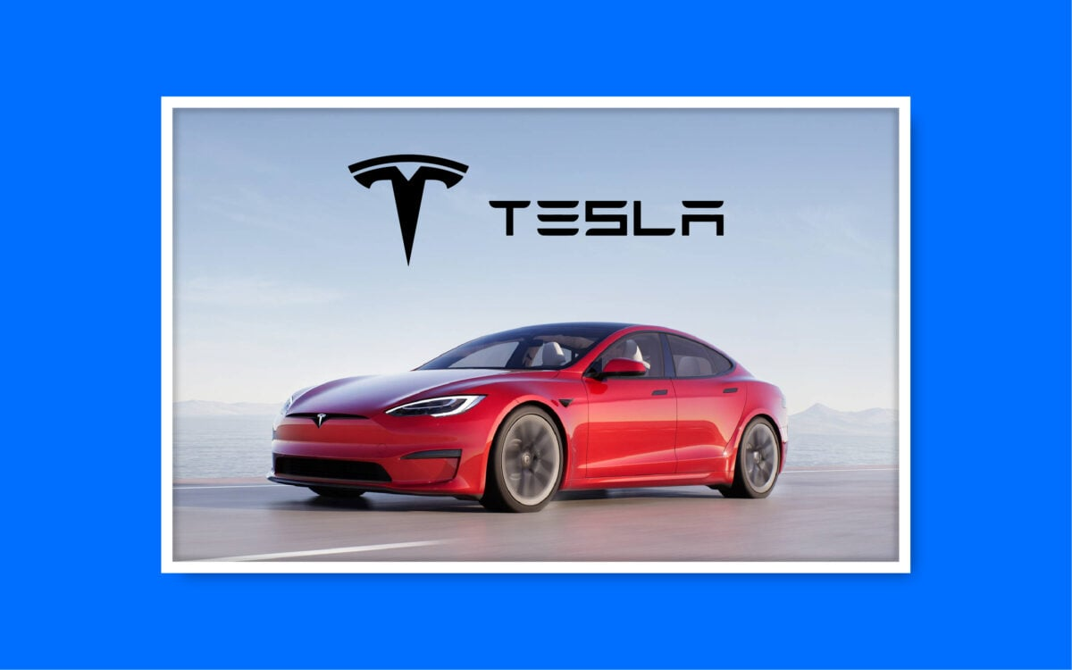
Tesla: Electric Cars, Solar & Clean Energy: A Strong Brand
While many consumers think of Tesla as an automaker, the brand increasingly positions itself as a high-performance energy company with a futuristic outlook. This strategy echoes in every touchpoint they offer (including their marketing), allowing the brand to occupy a “premium” position in each market they enter — with corresponding premium pricing models.

Slide 9
How to Apply Tesla's Strategy to Your Brand:
To emulate Tesla, you must position your brand as a forward-thinking pioneer in your industry. Your mission should resonate with prevailing societal values and reflect in every brand interaction.

Slide 10
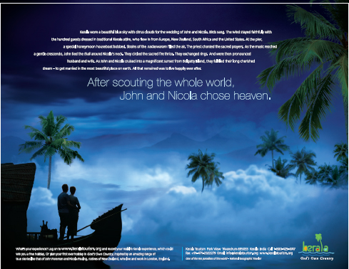
Kerala Tourism has successfully branded the destination with a brand name, logo, and the tagline “God’s Own Country”

Slide 11
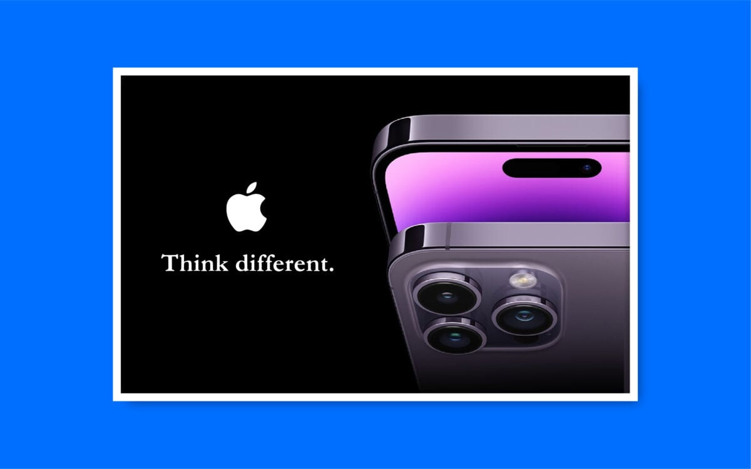
Apple: Think Different
Apple is a textbook example of a strong brand. They’re the first example Simon Sinek brings up in his Golden Circle framework, asking first why, then how and what.
Apple builds beautiful, innovative computers that are different from anything else in the market. Their message highlights the same qualities in their consumers in their products: if you are an Apple person, you are also innovative, imaginative, and creative.

Slide 12
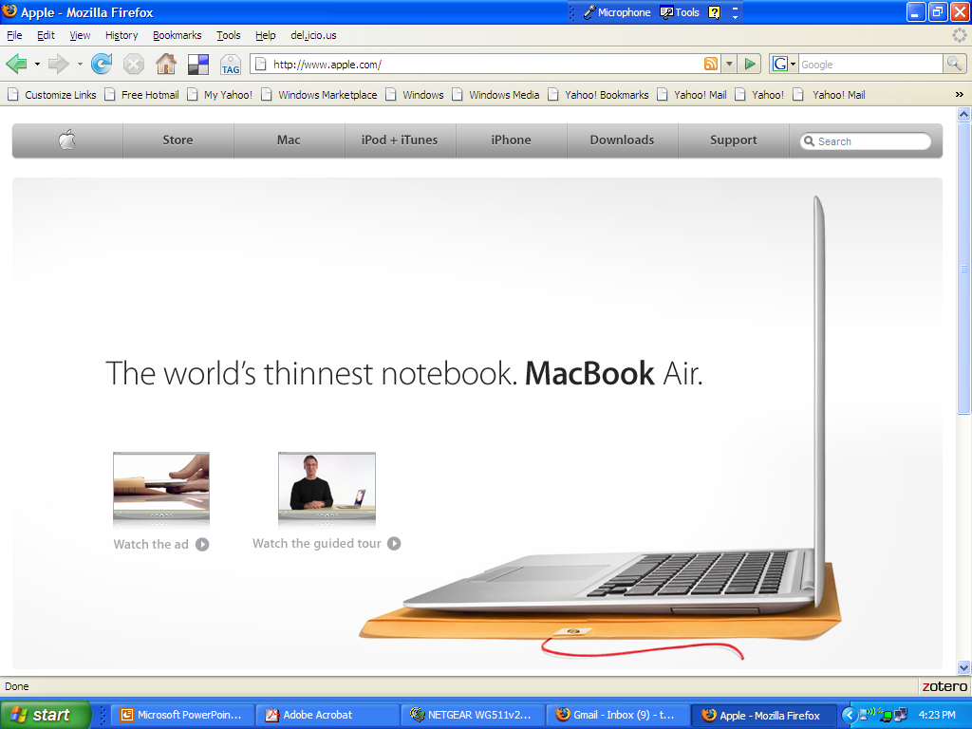
Apple is a Strong Brand

Slide 13
How to Apply Apple's Strategy to Your Brand:
Sometimes, actions speak louder than words. Instead of relying on explicit mission statements, embody your brand positioning in the quality and functionality of your products. Encourage customers to associate your brand with a particular lifestyle or set of values.

Slide 14
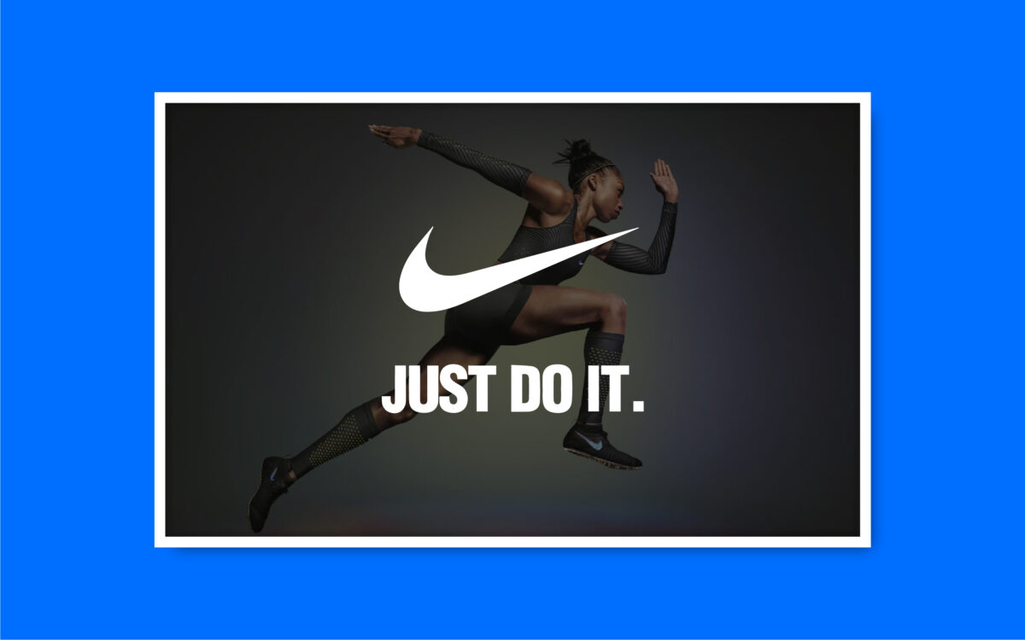

Slide 15
Nike: Just Do It
Nike started their product with a focus on performance and innovation. They invented the waffle shoe and built their brand by targeting professional athletes. The Nike product line has now expanded, offering athletic attire and equipment that enhances performance.
Their branding and messaging focus on empowerment, from their tagline “Just Do It” to their namesake, the Greek Goddess of Victory. Their models and athletes aren’t smiling and happy, they’re doing physical activities with game faces on.

Slide 16
How to Apply Nike's Strategy to Your Brand:
Incorporate a motivational aspect into your brand positioning. This will inspire your customers and create a deep emotional bond with your brand.

Slide 17
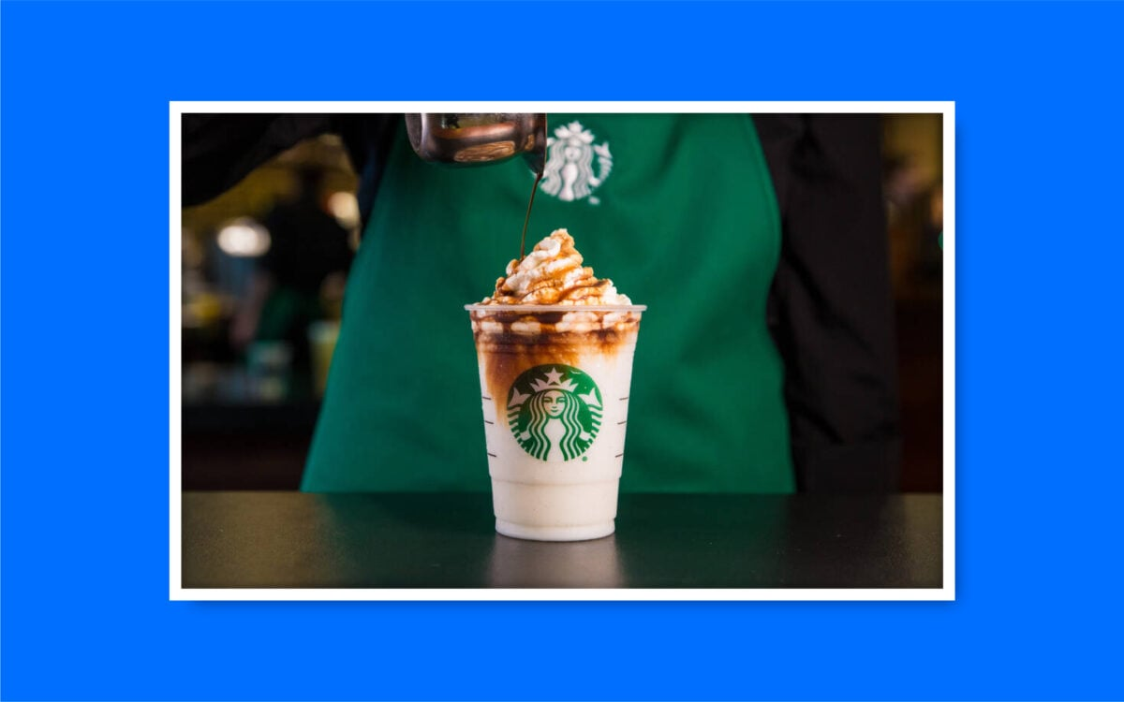

Slide 18
Starbucks
Committed to being more than just a coffee brand, Starbucks has built its identity based on experiences, community connections, and sustainability. Starbuck’s mission is to inspire and nurture its customers, wherever they are, through incredible experiences. As such, the company carefully constructs both its products and locations to adhere to the values of its customers. Every Starbucks Barista is trained to deliver excellent, personalized service, and every customer can expect the same quality of support when they visit a location. Starbucks’ brand identity also revolves around creativity.
The Starbucks siren makes us think of mythological stories and magic. The color palette of green and white highlights purity and growth.Starbucks also champions its customers in its marketing strategies, drawing attention to influencers and everyday consumers with its campaigns. Starbucks positions itself as a champion of community spirit, connecting with cultural and social movements around the world and constantly supporting its customers. Its tone of voice is welcoming and engaging, designed to make everyone feel like they’re part of something bigger.

Slide 19
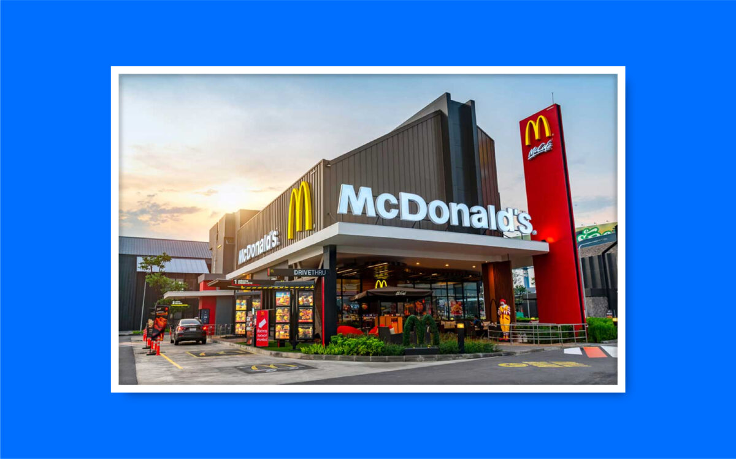

Slide 20
McDonald’s
The company’s visual identity, starting with the large golden “M,” makes us think of happiness and quality.
The McDonald’s locations are designed to be fun, friendly, and engaging for younger audiences. Even the packaging of products is designed to draw in new customers. McDonald’s has also been successful in the branding world because of its cultural awareness.

